Slide 1
Session 11

Slide 2
Content of session
1
Animation Player
2
State Machines

Slide 3
1
Animation Player

Slide 4
Animation Player
The AnimationPlayer is a node
that allows for more complex
animations and control over every details and aspect of them.
AnimationPlayer works for both 2D and 3D and lets you “key” certain values to the animation.
So with this concept, we don’t need frames only, we can use other properties like position, rotation etc.

Slide 5

Animation Player
Once you add the AnimationPlayer node to your scene, we’ll be working in the Animation tab.

Slide 6
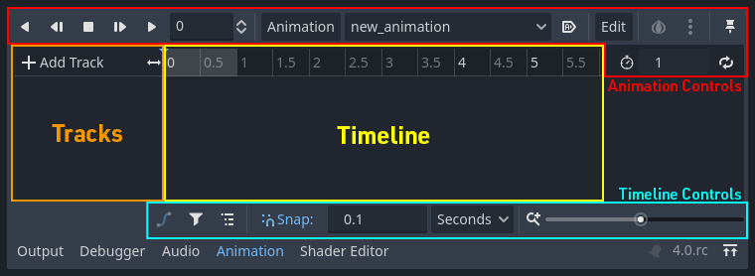
Animation Player

Slide 7
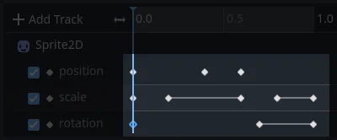
Animation Keyframes
A Keyframe defines the value of a property at a point in time. Diamond shaped indicate keyframes in a timeline. A line between 2 keyframes mean
that the values
hasn’t changed.

Slide 8
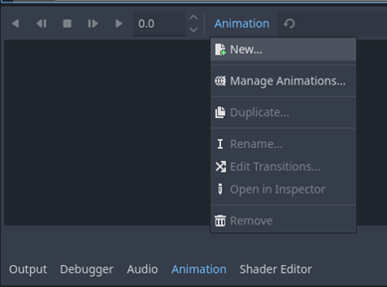
Animation Player Example
First create a new animation in the animation tab.

Slide 9
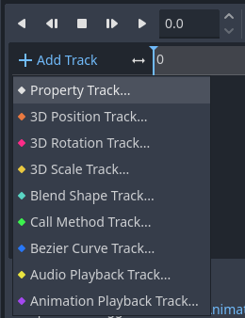
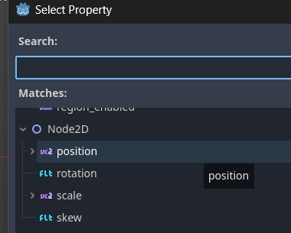
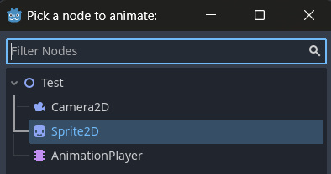
Animation Player Example
Then, click the “+ Add Track” button and choose “Property Track”, which will ask to chose a node, then choose a property.

Slide 10
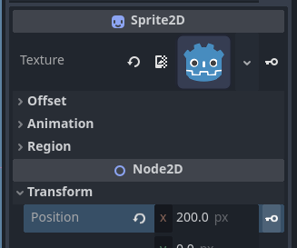
Animation Player Example
Now, we have the track ready, so we can add keyframes.
Click on the Sprite node, and you’ll see a key icon, click on it to add a keyframe with the property you chose.

Slide 11
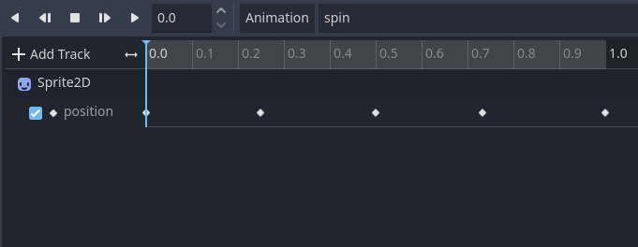
Animation Player Example
Enter all keyframes for the animation, and you can press the play buttons to test the animation in the editor.

Slide 12
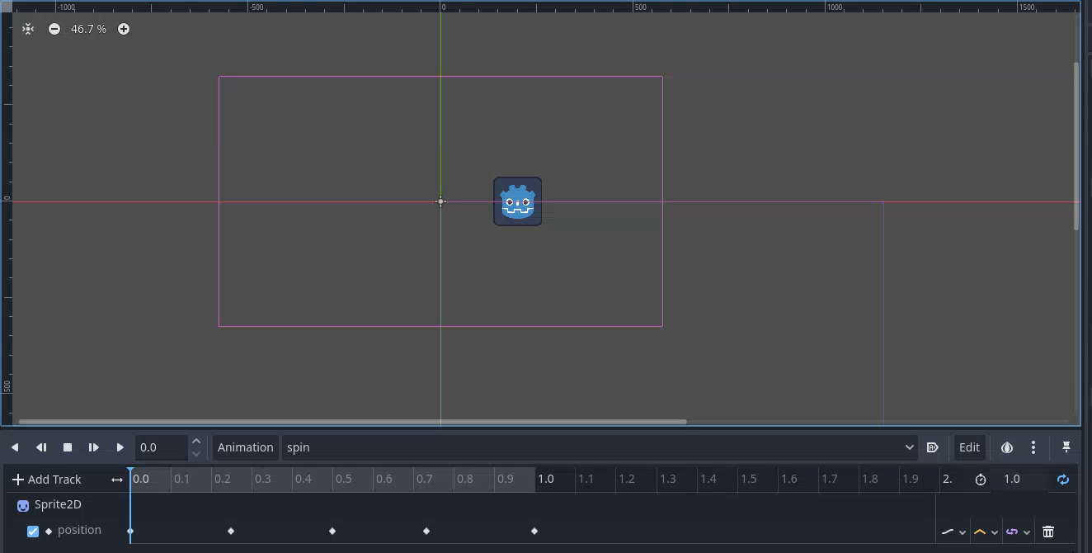
Animation Player Example

Slide 13
Animation Player Example
You can add more tracks using different properties or nodes to make your animation more detailed

Slide 14
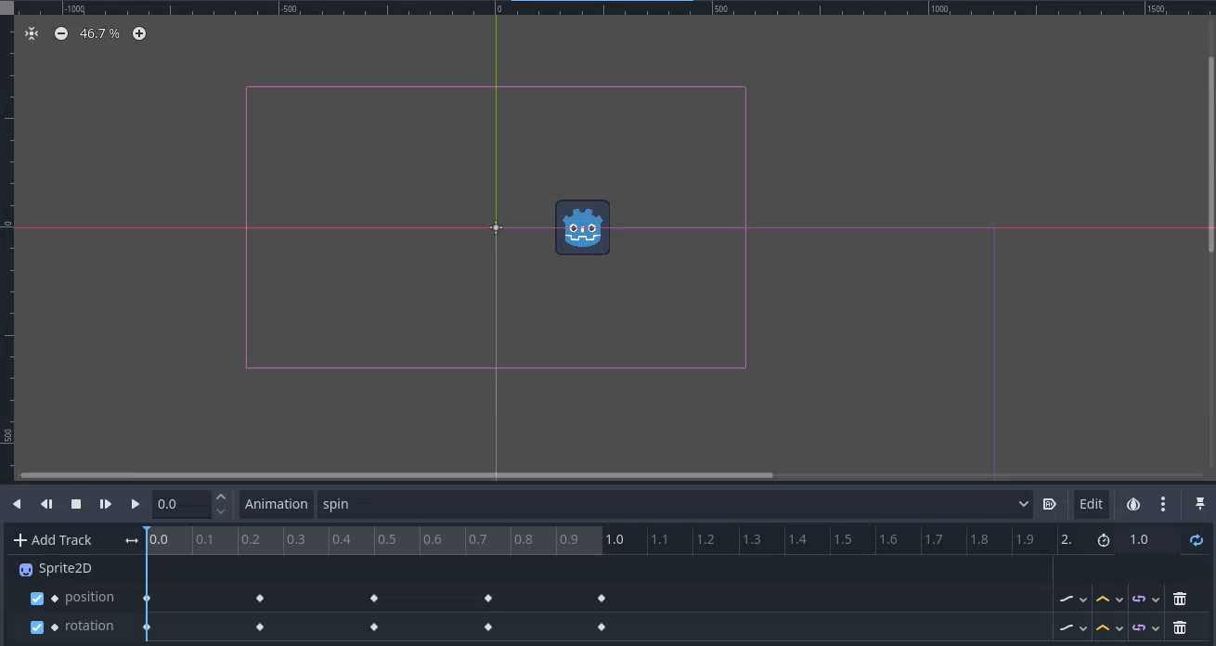
Animation Player Example

Slide 15
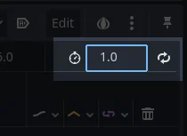
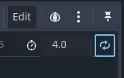
Animation Player
You can set the animation length in the control on the left side of the animation tab. You can also set the animation to repeat from the button next to it.

Slide 16
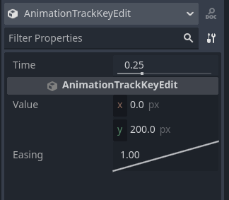
Animation Player
You can click on a specific keyframe in the animation timeline to display and edit its values in the inspector

Slide 17
2
State Machines

Slide 18
Finite State Machines
Finite state machines are a way to organize code, where there are multiple states and the machine can be one state at a time. Each state has specific behavior and functionality.

Slide 19
Finite State Machines
For Example:
In a platformer game, a player is able to stand still, walk and jump.
We handle all of this inside the code inside the process/physics_process functions

Slide 20
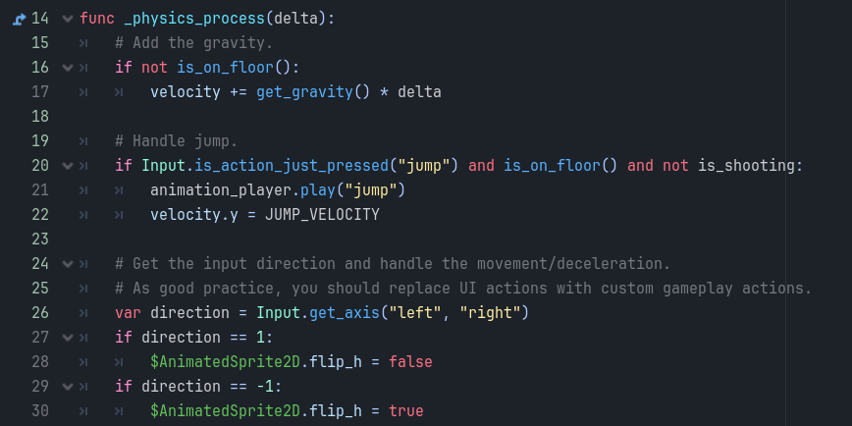
Finite State Machines

Slide 21
Finite State Machines
How do Finite state machines fix this? We define an enum with all possible states we will work with, and for each state we will add it’s own functions, so each state is the one responsible for its functionality.
For each one of these states will have its own node and own script that holds all functions it uses.

Slide 22
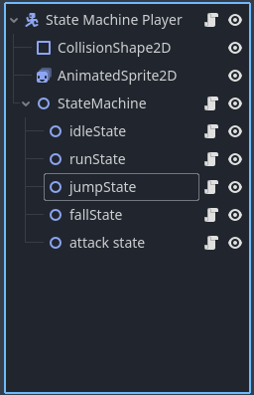
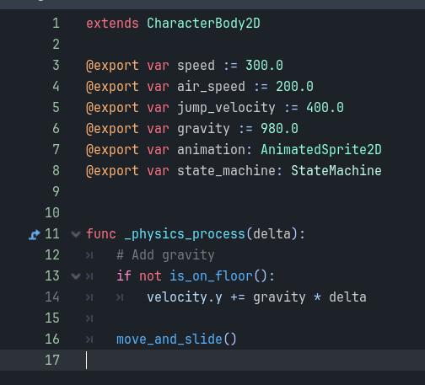
Finite State Machines

Slide 23
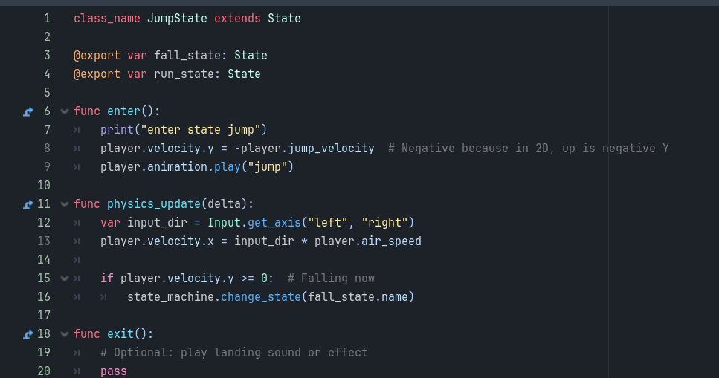
Finite State Machines

Slide 24
Thanks!
Any Questions

